Slide 1
Personal Property Narrative Appraisal Writing for Assessors
Winning with USPAP
Notes:
Everyone in the room hates personal property. There is a lot to hate. But once you have a deeper understanding of how to value personal property, your attitude could change. How do I know? I know because I learned how to value personal property from the ground up. Mid life I decided to change careers to become an auctioneer. Shortly after getting the license I realized I need to know the value of the items I was selling otherwise the buyers would have the upper hand.

Slide 2
Vision Statement
This session examines a USPAP compliant method for the Assessor to determine the apposite value for personal property. The method utilizes value characteristics and approaches to determine a value supported by evidence. Logic is explored and pitfalls revealed to equip the assessor to defend their value determinations to owners and Appellate Tax Board Commissioners. In this session the students will learn how to construct a value argument using classification, true premises and true conclusions. Resources will be explored, a live demonstration and hands on group assignment make this session worthwhile.

Slide 3
Goal and Objective
In this session you will learn to write a narrative appraisal report of personal property in a USPAP compliant report.
If you know how one is written, and you need to hire an appraiser to support a ATB case, then you will know if their report is credible.
With the report you could convince abatement applications to withdraw due to a lack of proof against your value.
While the burden of proof is on the applicant, an Assessor USPAP report to a Commissioner is a concrete foundation for a decision in your favor.
The SJC respects USPAP if there is ever an appeal.

Slide 4
Today’s Situation
To Summarize the current situation: you hate personal property…
You are not comfortable with the process
You don’t know what some of the personal property is.
It is complicated.
The depreciation schedules are a mystery.
The differing forms of ownership and taxation are complex.
You wish you could simply farm it out to a supplier, or have.
BUT: Personal Property can be big bucks, and it is likely taxable.

Slide 5
Sample Personal Property Narrative Appraisal Report
Intended Use
Scope Of Work
Definition of value
Property Appraised
Limiting Conditions
Method of Valuation
Reconciliation
Certification
Research
Qualifications

Slide 6
When Did Personal Property become Taxable?
EGYPT
During the various reins of the Egyptian Pharaohs (3150BCE– 305 BCE) tax collectors were known as scribes.
During one period the scribes imposed a tax on cooking oil. To insure that citizens were not avoiding the cooking oil tax scribes would audit households to insure that appropriate amounts of cooking oil were consumed and that citizens were not using leavings generated by other cooking processes as a substitute for the taxed oil.

Slide 7
How Did We Get Here?
COLONIAL AMERICA
Colonists were paying taxes under the Molasses Act which was modified in 1764 to include import duties on foreign molasses, sugar, wine and other commodities. The new act was known as the Sugar Act.
Because the Sugar Act did not raise substantial revenue amounts, the Stamp Act was added in 1765. The Stamp Act imposed a direct tax on all newspapers printed in the colonies and most commercial and legal documents.

Slide 8
How Did We Get Here?
POST-REVOLUTION AMERICA
In 1794 Settlers west of the Alleghenies, in opposition to Alexander Hamilton's excise tax of 1791, started what is now known as the "Whiskey Rebellion"
The excise tax was considered discriminatory and the settlers rioted against the tax collectors .
President Washington eventually sent troops to quell the riots. Although two settlers were eventually convicted of treason, the President granted each a pardon.

Slide 9
How Did We Get Here?
Massachusetts Today: City And Town February 2, 2017
“The personal property account is an area where municipalities can typically see large increases in growth. As a result, we encourage assessors to review all personal property accounts, including the prior year’s assessed values.”

Slide 10
Review High Value Property Costs
Examples today in Taunton:
  Compactor $156,500
  Bailer/Compactor $300,000
  Advertising Screen $130,000
  Friolator $125,000
  Movie Projector $393, 872
Single Printing Location $6, 000,000 January 1, 2017
  Will be $25,000,000 on January 1, 2018
Distributor Automated Material Handling System
    $5,000,000 January 1, 2016, $25,000,000 January 1, 2017

Slide 11
ANYONE DONE THIS?
M.G.L. CH 59 §31A
The assessors may compel production of books, papers, records and other data of the person through issuance of a summons served in the manner as summonses for witnesses in criminal cases issued on behalf of the commonwealth and all provisions of law relative to summonses in such cases shall, so far as applicable, apply to summonses issued under this section.

Slide 12
ANYONE DONE THIS?
M.G.L. ch 59 §32
Lists filed under Section 29 and books, papers, records and other data obtained under section 31A shall be open to the inspection of the assessors, the commissioner, the deputies, clerks and assistants of either the assessor or the commissioner and any designated private auditor… shall not be open to any other person except by order of the court

Slide 13
High Value Property, Now What?
You are (sort of) assumed right untill proven wrong. Best to prove to yourself that you are right. After you are convinced, share it with the taxpayer.
USPAP, since 1989, is your friend.
USPAP STANDARD 6 MASS APPRAISAL DEVELOPMENT AND REPORTING is being re-written by the Standards Foundation as we speak.
One Standard for appraisal Development, another for appraisal reporting.
Luckily, we have USPAP STANDARDS 7 & 8 for personal property

Slide 14
USPAP Standard 7
    One must do what is expected from the typical Assessor:
      Identify the problem to be solved
        What will it take to convince the audience you have a credible valuation?
          Sales, Income or Cost approach. (which cost? .. And the ATB hates Cost.)?
        Set the Scope of work
        Research Plan

Slide 15
USPAP Standard 8
    Reporting will follow the USPAP and this course outline
      Communicate the analysis, opinion and conclusion
      Include more than sufficient information
      Identify assumptions
      Build a valid argument
      Any reasonable mind to the same conclusion

Slide 16
THE M.G.L. ON VALUATION
CQ 22. How is personal property valued in Massachusetts?
A 22. Like real estate, all personal property must be assessed at fair cash value. Generally, personal property is valued using the cost method. The particular method will vary, depending on the specific property. In some cases, such as highly regulated utilities, net book will be used, which is original cost less depreciation. In other cases a reproduction or replacement cost new less depreciation method is used.
Ordinarily the market and income approaches do not lend themselves to personal property valuation. However, if a specific property or type of property has a demonstrated resale value in the market or a specific earning capacity as leased property that can be distinguished from business earnings, a market or income approach may also be used.
In most cases the local board of assessors in the town where the personal property is situated is responsible for valuing and assessing the personal property. However, in the case of telephone and telegraph companies and pipeline companies, the Commissioner of Revenue determines the values and notifies the local boards of assessors, which then assess the local taxes. See answers to Question 24 and Question 25 for central valuation procedures for telephone & telegraph companies and pipeline companies, respectively.
See M.G. L. c. 59, §38, 38A, & 39-42.

Slide 17
M.G.L.
Chapter 59 Section 38 covers assessor duty.
Boston Gas Company v. Assessors of Boston, 334 Mass 549 (1956) defines the value as “Fair cash value means fair market value, which is defined as the price on which a willing seller and a willing buyer will agree if both of them are fully informed and under no compulsion.”
However, there are many levels of prices in the marketplace.
Personal property is valued for taxation in MA, at the price a dealer who trades in the secondary market of the product would pay the owner.

Slide 18
WHERE DO YOU START?
APPROACH TO VALUE – build a plan
What does the personal property do, how does it do it, who made it.
There is more than one company making the item, look for generics
Sometimes it is easier to find a new similar item, age it through inflation calculator
Somewhere there is another one of these being assessed by someone else
If it is one of a kind you must go to cost or income approach

Slide 19
USPAP Product Description
INSPECT THE PROPERTY PERSONALLY
  Obtain images 360 degrees if possible including nameplate if existing
    Use a white Sharpie to highlight engraved numbers and letters
    Review the images before you leave to ensure there is readable detail
    Ask questions, take physical notes, source the supplier

Slide 20
USPAP Product Description
INSPECT THE PROPERTY PERSONALLY
  Obtain images 360 degrees if possible including nameplate if existing
    Use a white Sharpie to highlight engraved numbers and letters
    Review the images before you leave to ensure there is readable detail
    Ask questions, take physical notes, source the supplier

Slide 21
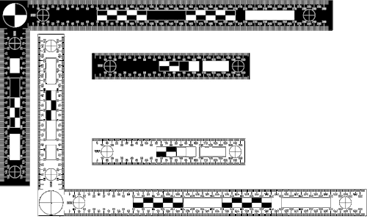
USPAP Product Description
  Include a scale in all your pictures, they are evidence.

Slide 22
LINK THE ATTRIBUTES
Type of Object
Measurements
Materials and Techniques
Manufacture Date
Maker
Distinguishing Features

Slide 23
3 APPROACHES TO VALUE
1 COST METHOD
Assessors usually use the cost method to estimate the value of personal property, typically relying on industry cost manuals.
Acquisition Cost (RCN, retail to the present owner) includes any expense required to place the asset into service except sales tax. Includes all charges for transportation, installation, accessories, and profit and overhead, as well as additions to or renovations of the property other than routine maintenance or repairs.
Expected life to each major industrial classification grouped by NAICS code. For example, all industries classified as Agriculture and Forestry (NAICS .11) have 15 year lives, while Mining (NAICS .21) assigns a 20 year life to Oil and Gas Exploration (NAICS .2111) and a 15 year life to Mining (NAICS .2121 & .2122).
Cost Conversion factor.

Slide 24
COST APPROACH TO VALUE
REPRODUCTION COST METHOD
This may be reproduction, replacement or insured value.
ORIGINAL COST LESS DEPRECIATION METHOD
The ORIGINAL SALES RECIPT and depreciation schedule or Cost Conversion Factor set by the Board of Assessors.

Slide 25
APPROACH TO VALUE
INCOME METHOD
The income and expense approach to the operating machinery is reliable with a credible argument, rarely used in personal property valuations.
Rented machinery such as copy machines, sewing machines, backhoes, network equipment, Rent-All Equipment Co., it is out there.
  Operating Lease has a purchase option at the end of the term @ FMV
  Financing Lease is a conditional sales contract, on user’s depreciation schedule and taxes

Slide 26
APPROACH TO VALUE
MARKET SALES METHOD
The economic principle of substitution, that process of identifying alternatives that would satisfy the same need is the underlying principle for all three approaches but most evident in the sales approach. Here the machinery having the same utility with the lowest price creates the most demand.
Watch the adjustment they must be credible with matched pair analysis or time factors such as inflation calculators.

Slide 27
In any Approach
Model numbers very helpful
Within three years if using sales
Fewest adjustments as possible, cite justification
Aged $ can easily be adjusted for inflation
  US Bureau of Labor and Statistics inflation calculator
MSRP has merit for taxation

Slide 28
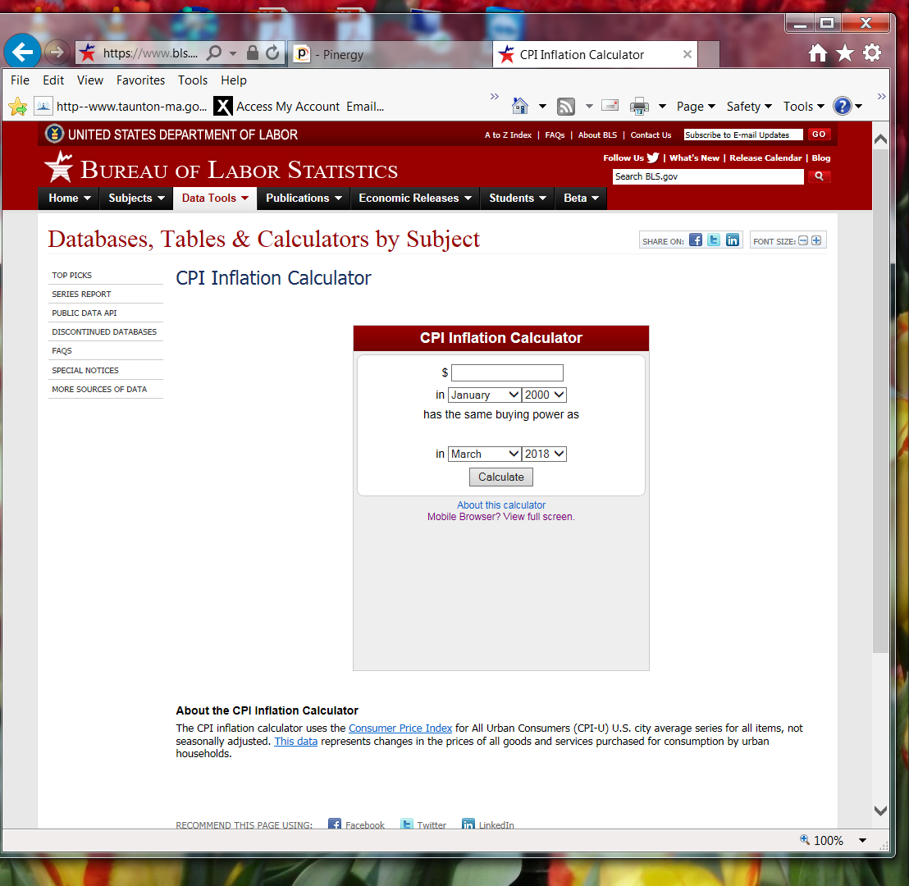

Slide 29
Sales Approach
Auctions best source and are in the secondary market
eBay will surprise you
Used Equipment Dealers are highly specialized, and private
Equipment Manufacturer catalogs are your best friend
Interviews with manufacturers
Interviews with manufacturer’s Representatives

Slide 30
WHERE DID YOU GET THE MOST DATA?
APPROACH TO VALUE
MARKET SALES METHOD
The market sales approaches may GENERATE THE MOST DATA and the more you have, the more reliable and credible it can be if it is presented in a credible manner, thus it has wide application in the vast majority of personal property valuations.
Leave it up to the Commissioner to determine if physical evidence in the market is overshadowed by a cost spreadsheet.

Slide 31
DEPRECIATION
Depreciation must be based on age, condition and quality of the property.
Property still in use has a utility value, even if its life expectancy has been exceeded and it has zero value for accounting or regulatory purposes.
Generally property in use should not be depreciated below 20%, although depreciation to as low as 5% might be appropriate where economic obsolescence principles apply.
Assessors must document depreciation allowances
USPAP: defend depreciation in reconciliation

Slide 32
26 US Code § 167 – Depreciation (IRS)
(a) General rule There shall be allowed as a depreciation deduction a reasonable allowance for the exhaustion, wear and tear (including a reasonable allowance for obsolescence)— (1) of property used in the trade or business, or
(2) of property held for the production of income.
(b) Cross reference For determination of depreciation deduction in case of property to which section 168 applies, see section 168.
(c) Basis for depreciation (1) In general The basis on which exhaustion, wear and tear, and obsolescence are to be allowed in respect of any property shall be the adjusted basis provided in section 1011, for the purpose of determining the gain on the sale or other disposition of such property.
(2) Special rule for property subject to lease. If any property is acquired subject to a lease— (A) no portion of the adjusted basis shall be allocated to the leasehold interest, and (B) the entire adjusted basis shall be taken into account in determining the depreciation deduction (if any) with respect to the property subject to the lease.

Slide 33
ASSESSORS SET CONVERSION FACTORS
In Massachusetts the Board of Assessors set the depreciation schedule for the community.
M.G.L. ch 59 §
Industries have differing depreciation schedules in accounting.
Well drilling vs Construction

Slide 34
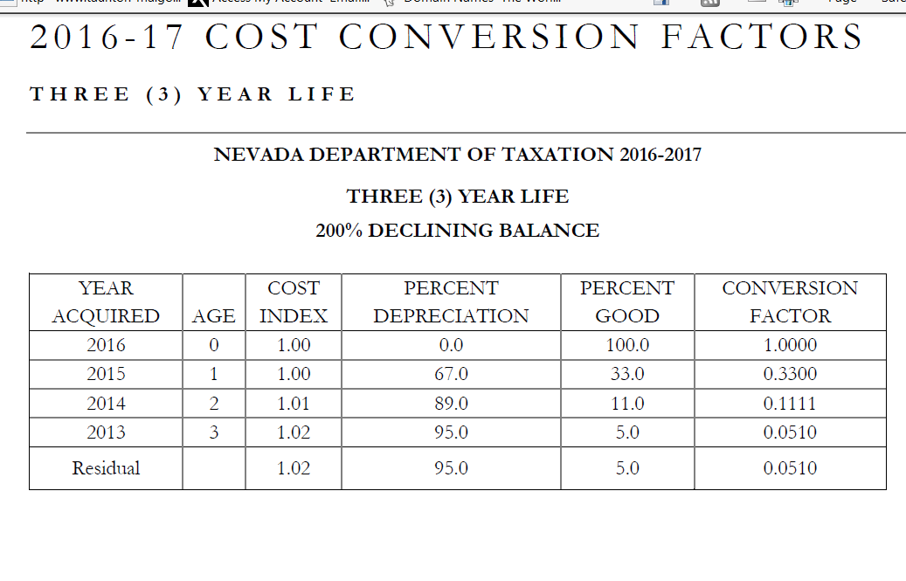
EXAMPLE OF CONVERSION FACTORS

Slide 35
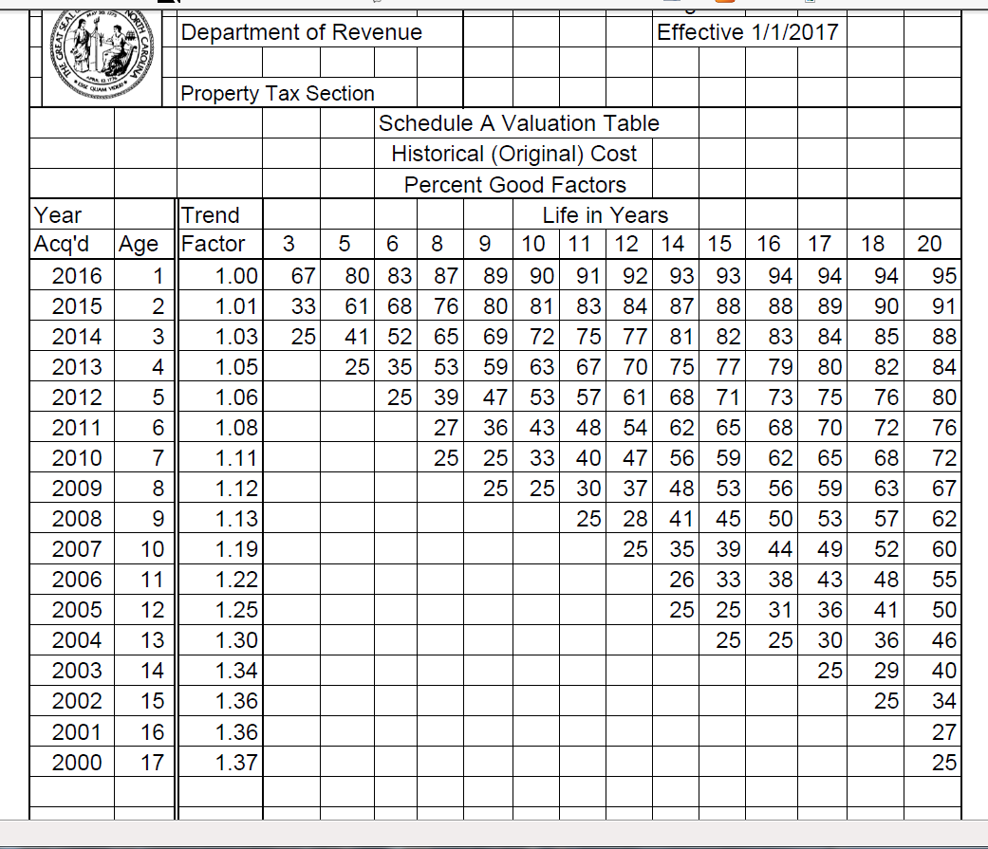
EXAMPLE OF CONVERSION FACTORS

Slide 36
Recommendation
Start your search for comparable value on a wide sweep. Use web sites such as machinio.com and eBay.com or start by searching for prices new and apply discount for age.
Discount for depreciation can be found in the United States Bureau of Labor and Statistics for machinery by type.
Summarize the results with as much support you can find
Build a logical argument to link what you learned to what you know
Identify weaknesses in the argument and get more information to strengthen the argument.
Write a USPAP compliant report, if you do it right it will be bullet proof.
Notes:
The North American Industry Classification System (NAICS) replaced the Standard Industrial Classification (SIC) in 1997.

Slide 37
Using Logic to your advantage
An argument is made up of one or more premises and is followed by one or more conclusions.
A premise is a statement of fact: “Socrates is a man.”
Arguments can be valid or invalid
Each premise has to be true and cannot be proven false
If all the premises are true the conclusion has to be true

Slide 38

Drawing is speaking to the eye;
Talking is painting to the ear,
Writing is sculpting the mind.
An argument is a work of fine art.

Slide 39
Using Logic to your advantage
In a narrative appraisal it is the reconciliation and conclusion which is the argument of a chain of premises which conclude in a value conclusions.
The description of property covers the factual features of the item
The research finds similar features and makes adjustments for differences
Linking the similarities is assembling the premises in an argument
Do not stray from the facts, do not stretch to find them

Slide 40
Structure of Arguments
Powerful appraisal arguments come from an outline of the facts that follow a concept.
The facts are Propositions (statements)
Singularly they are concrete.
Grouping the Propositions and comparing them and contrasting them builds an abstract argument.

Slide 41
Premise
Imply or entail the conclusion, give me a hint where we are going.
The truth of the premise guarantees the truth of the conclusion
Two or more premises are equivalent if they imply each other
A premise which can be true or false is contingent.
If it is impossible for a premise to be true, it is contradictory.
True premises, even contingent but not contradictory are satisfiable

Slide 42
Premise traps to avoid
Connotations
Metaphors
Conjunctions
Words which assert: think, indication, tendancy, estimate, suspect. Rather than words which are non-asserting: know, acknowledge, proves, demonstrates, realizes

Slide 43
Argument Traps: Appraisal Fallacies
Subjectivism: The belief or desire of the appraiser is evidence of a true premise.
Appeal to Majority: appraiser states a large number of people believe it thus a premise is true.
Appeal to Emotion: appraiser premises build an emotion to support a conclusion
Appeal to Force: appraiser persuades through threats (impending lawsuit)

Slide 44
Appeal to Emotion
Appeal to Envy (AKA, Argumentum ad Invidiam)
Appeal to Fear (AKA, Argumentum ad Metum)
Appeal to Hatred (AKA, Argumentum ad Odium)
Appeal to Pity (AKA, Argumentum ad Misericordiam)
Appeal to Pride (AKA, Argumentum ad Superbiam)
All subjective fallacies because they are not facts

Slide 45
Emotion to support a conclusion
Works when trying to get some one to act ($100 will feed a family in Africa for a year), fails when used to change their beliefs.
The appraiser is writing for a reader who wants to believe it is true, which is no reason to believe it is true. Or fears that it is true and has no reason to believe it is false.

Slide 46
Argument construction
In the concept of personal property there is a sub classification of Business & Industrial (B&E) machinery.
B&E includes the species of Manufacturing & Metalworking
M&M are divided into genus including Metalworking Tooling
The Metalworking group of CNC Turning Centers attract specific dealers (and are therefore mutually exclusive and jointly exhaustive)
The Daewoo Puma 230C was mass produced and is regularly sold
7 offered on eBay in the last 30 days with a median offering of $33,147.50 and an mean of $39,600

Slide 47
Simple Arguments
Starts with some assertions (premises) justifying a thesis (conclusion)
“We have made assumptions that the items we inspected were what we thought them to be. We believe the Scope of Work gave us complete data. We have complied with the requirements of Standard 7 and 8, Personal Property Appraisal Development and Reporting of the Uniform Standard of Professional Appraisal Practice. In our professional opinion the market value of the entirety, as of January 1, 2017, was one thousand dollars.”

Slide 48
Simple Arguments
The concept of a valuation conclusion is a group of information formed by comparison and contrast.
Regardless of the approach to value, in the end, the assessor must reconcile the data. Expose the data in groups of relevance then relate its meaning to the assignment.

Slide 49
Logical Fallacies
Circular Argument: appraiser fails to address the valuation issue, the premise supports only the premise.
Circulus in Probando; the appraiser begins with what they want to end with, thus the reconciliation goes around in a circle.
A is true because B is true. B is true because A is true.
“The listing price of this buildable lot was based on the assessed value.”

Slide 50
Logical Fallacies
Post hoc, ergo propter hoc: appraiser uses a preceding unrelated event to reach a valuation conclusion. Latin translates to “After this, therefore because of this”.
A caused B because A occurred before B
The exhibition is actually the reason that the 1892 oil painting was sold; the Gauguin canvas had been on loan to the Kunstmuseum in Basel for close to 50 years, but the institution would not let the artwork travel while it was closed for renovations. This violated the terms of the loan, which stipulated that the painting remain on public view.

Slide 51
USPAP Compliant Report
  Identity of the Taxpayer and Commissioners
  Intended use of the appraisal is to determine the (taxable) full and fair cash value. Cite MGL
  Identify the item appraised in a description of property incliuding as much detail as possible
  Does the taxpayer wholly own the property?
  Cite the definition of Value, as an MGL
  Identify the effective date as January 1 (year) for the appraisal and the date the report was written
  Summarize the Scope Of Work (what you did and did not do, to determine the value)
  Sumarize the information reason for adjustments, proof of adjusted values, use of the property
  Market Analysis
  Statement of Assumptions and limiting conditions
  Include certification from USPAP
  Two original digital signatures

Slide 52
Logical Fallacies
False Alternative: appraiser does not consider all relevant possibilities.
Appeal to Ignorance: appraiser takes a position that it must be true because it has not been proven false
Non Sequitur: appraisers conclusion does not follow the premises
Non Sequitur includes Diversion and Straw Man (arguing a proposition against another)

Slide 53
Logical Fallacies
Appeal to Authority: appraiser relies on experts not competent to address the subject.
Ad Hominem: appraiser addresses a person rather than valuation.
Ad Hominem includes “poisoning the well” appraiser critiques another for a non-rational motive
Ad Hominen includes “you’re another” appraiser critiques another in effort to prove a position.
Most often seen in appraisal reviews.

Slide 54
USPAP Compliant Report
Write an Overview, executive summary of the situation.
Name the Intended Users as the Taxpayer and all of the Commissioners at the Appellate Tax Board.
The Intended Use is to resolve differences in opinion of value for Massachusetts Personal Property Taxation
The Scope of Work is what you chose to do to find a defendable and credible value as well as what you chose not to do if anything.
The Definition of value needs to be footnoted with the legal citation.
The Effective date of the Appraisal is January 1 of the tax year in dispute.

Slide 55
ATB Case #17p018 Carver Realty v Town of Carver
  Adjustments must be supported
  “Mr. Collins failed to adequately adjust his purported comparable sales, and therefore his analysis lacked credibility. Accordingly, the Board found and ruled that the appelant failed to meeet the burden of proving that the subject property was overvalued.

Slide 56
ATB Case #16p479 Star magrit ETR v. City of Woburn
  Assessor (appellee) presumed correct until proven wrong
  In reaching its opinion of fair cash value in these appeals, Board was not required to believe the testimony of any particular witness or to adopt any particular method of valuation. Rather, the Board could, and did, accept those portions of the evidence that the Board determined had more convincing weight. Foxboro Associates v. Assessors of Foxborough, 385 Mass. 679, (1982); New Boston Garden Corp. v. Assessors of Boston, 383 Mass. 456, 473 (1981); Assessors of Lynnfield v. New England Oyster House, Inc., 362 Mass. 696, 702 (1972).

Slide 57
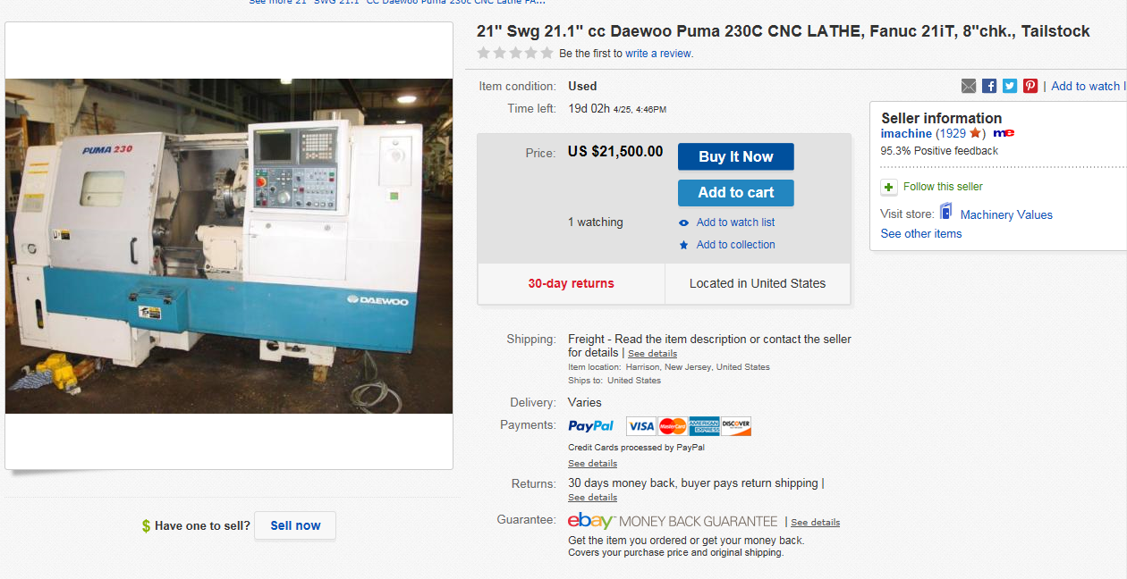

Slide 58
Live Demonstration

Slide 59
Resources
Adams, Charles, 1993, For Good and Evil: The Impact of Taxes on the Course of Civilization, Madison Books.
2 Rehnquist, William H. 1992 Grand Inquests :The Historic Impeachments of Justice Samuel Chase and President Andrew Johnson. William Morrow & Company, Inc. New York, NY.
3Steuerle, C. Eugene The Tax Decade
4 Adams, Charles 1998 Those Dirty Rotten TAXES, The Free Press, New York NY
USPAP 2016 – 2017 edition, The Appraisal Foundation

